Slide 1

Sign Language Recognition
A Machine Learning & Computer Vision Based Translator
Technical Review • Final Presentation

Slide 2
Methodology Overview
A step-by-step technical conversion from visual gesture to audible speech

Slide 3

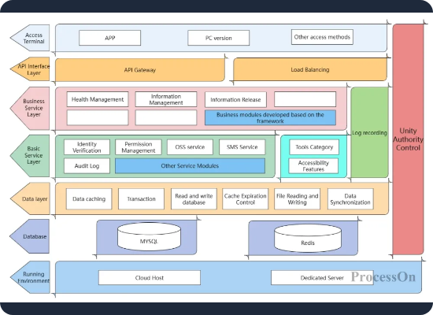
System Architecture
The proposed system follows a modular pipeline designed for real-time inference:
•
Input: Continuous video stream capture.
•
Processing: Spatial landmark extraction via MediaPipe.
•
Output: Dual-channel output (Subtitles & TTS Audio).

Slide 4



Phase 1: Capture & Pre-processing
Step 1: Video Capture
Frame Extraction
The system utilizes a standard webcam to capture real-time hand gestures. Frames are extracted at 30 FPS for smooth processing.
Each frame is processed individually, converted to RGB, and resized to match the model's expected input dimensions.

Slide 5
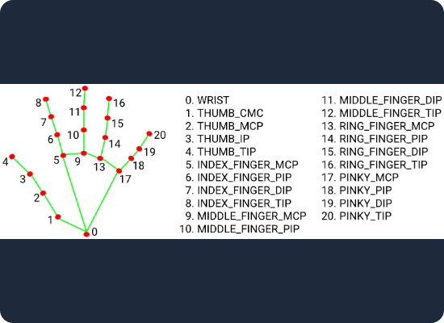
Step 2: Landmark Extraction
MediaPipe Hand Detection
We leverage the MediaPipe framework to identify 21 key hand landmarks. This provides several advantages:
•
High precision coordinate mapping.
•
Low latency (optimized for mobile/desktop).
•
Resilience to varying lighting conditions.

Slide 6
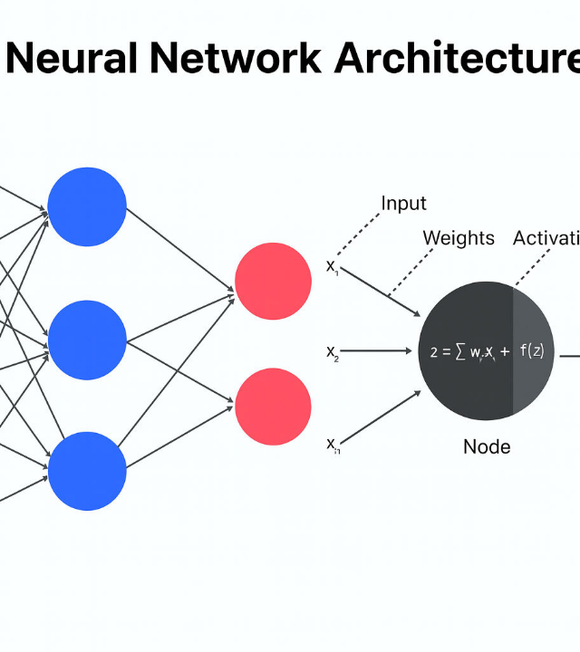
Step 3: Gesture Recognition
Machine Learning Model
Extracted landmarks are passed to a trained deep learning model. The model classifies the spatial relationship between points into specific alphabets or words.
"The engine of the system where spatial geometry becomes semantic meaning."

Slide 7


Phase 3: Multi-Modal Output
Step 4: Text Generation
Step 5: Audio Output
Recognized gestures are instantly displayed as subtitles on the interface, providing visual confirmation of the sign.
Generated text is passed to a Text-to-Speech (TTS) engine, allowing for audible communication in real-time.

Slide 8
Simplified System Flow
Camera
Detection
Recognition
Text Output
Audio
Real-time Input
Hand Landmarks
ML Classification
Subtitles
TTS Conversion

Slide 9
Hardware Specifications
Component | Minimum Requirement
Processor | Intel i5 / Equivalent or Higher
RAM | Minimum 8 GB
Camera | Built-in or External HD Webcam
Storage | Minimum 20 GB Free Space
System Type | Laptop / Desktop

Slide 10






Software Ecosystem
Languages
Frameworks
ML Libraries
Python (ML Backend) JavaScript (Frontend)
React.js (Frontend) Flask / FastAPI (Backend)
MediaPipe, OpenCV TensorFlow / Keras

Slide 11
Technical Justification
MediaPipe Landmark Accuracy
21
We chose MediaPipe because it provides incredibly fast hand landmark detection for real-time applications without requiring specialized GPU hardware.
Combined with Python, the system benefits from a massive ecosystem of computer vision libraries and community support.

Slide 12

Questions?
Thank you for your time.
Sign Language Recognition System Review 2024

Slide 13




Image Sources
https://cdn.processon.io/admin/knowledge/article_content_img/67ecf9cf45b96a5aedca958c.png
Source: www.processon.io
https://mediapipe.dev/images/mobile/hand_landmarks.png
Source: mediapipe.readthedocs.io
https://ik.imagekit.io/upgrad1/abroad-images/imageCompo/images/ChatGPT_Image_Nov_20_2025_03_47_56_PMTT18DE.png
Source: www.upgrad.com
https://static.vecteezy.com/system/resources/previews/037/044/900/non_2x/abstract-colorful-technology-line-wave-background-modern-purple-blue-gradient-flowing-wave-lines-futuristic-technology-concept-illustration-pro-vector.jpg
Source: www.vecteezy.com

